Slide 2
Jeremiah 6:16
“Thus saith the LORD, Stand ye in the ways; and see, and ask for the old paths, where is the good way, and walk therein, and ye shall find rest for your souls. But they said, We will not walk therein.”

Slide 3
Seeking the Old Paths

Slide 4
Seeking the Old Paths
OLD ?!?!?!?!?!?!

Slide 8
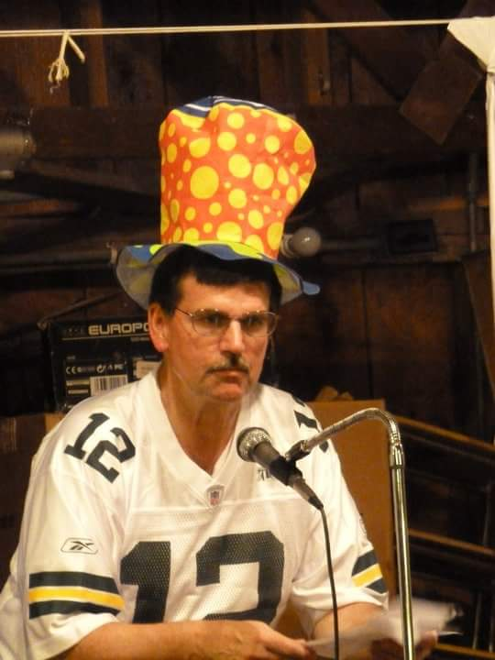

Slide 9
Old bad

Slide 10
Old bad

Slide 11
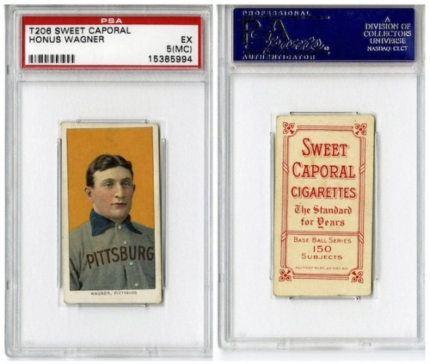
$2,800,000

Slide 12
Job 22:15
“Hast thou marked the old way which wicked men have trodden?”

Slide 13
Romans 15:4
“For whatsoever things were written aforetime were written for our learning, that we through patience and comfort of the scriptures might have hope.”

Slide 14
Romans 15:4
“For whatsoever things were written aforetime were written for our learning, that we through patience and comfort of the scriptures might have hope.”

Slide 15
Romans 15:4
“For whatsoever things were written aforetime were written for our learning, that we through patience and comfort of the scriptures might have hope.”

Slide 16
I Corinthians 10:11
“Now all these things happened to them as examples, and they were written for our admonition, upon whom the ends of the ages have come.”

Slide 17
I Corinthians 10:11
“Now all these things happened to them as examples, and they were written for our admonition, upon whom the ends of the ages have come.”

Slide 19
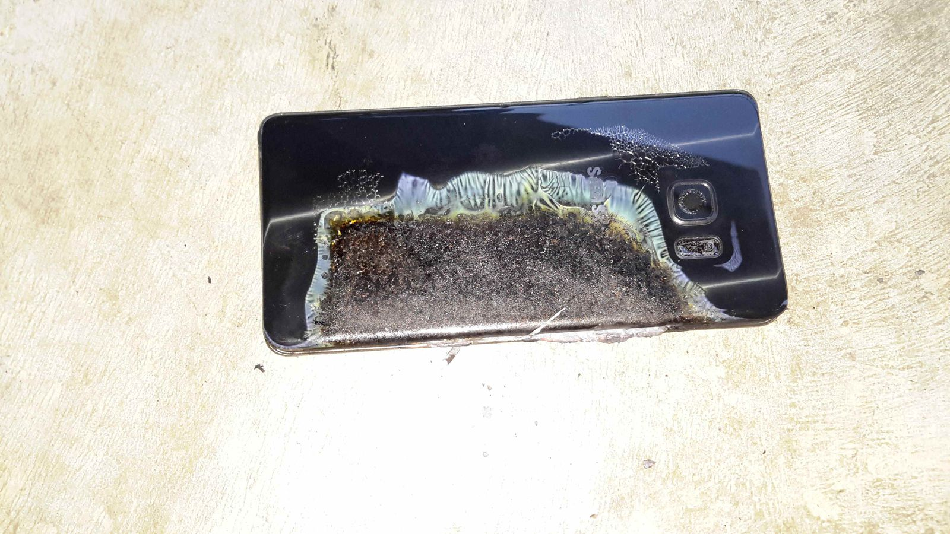

Slide 20
Acts 17:16-21
21) “(For all the Athenians and strangers which were there spent their time in nothing else, but either to tell, or to hear some new thing.)”

Slide 21
Acts 17:16-21
21) “(For all the Athenians and strangers which were there spent their time in nothing else, but either to tell, or to hear some new thing.)”

Slide 23
Back to the Basics
Job 8:8 – For enquire, I pray thee, of the former age, and prepare thyself to the search of their fathers:
Deuteronomy 32:7 – Remember the days of old, consider the years of many generations: ask thy father, and he will shew thee; thy elders, and they will tell thee.

Slide 24
Seeking the old paths means: finding the RIGHT/GOOD way.

Slide 25
Proverbs 14:12, 16:25
“There is a way that seems right to a man, But its end is the way of death.”

Slide 26
Psalm 119:105
“Thy word is a lamp unto my feet, and a light unto my path.”

Slide 27
Proverbs 3:5-6
“Trust in the LORD with all thine heart; and lean not unto thine own understanding. 6) In all thy ways acknowledge him, and he shall direct thy paths.”

Slide 28
Seeking the old paths means: finding the RIGHT/GOOD way. which means: THERE IS A RIGHT/GOOD WAY.

Slide 29
Have fun while you can
What’s right for you
is right for you
You can’t tell me I’m wrong…
it’s what I want to do
Do whatever feels good
Love is Love

Slide 30
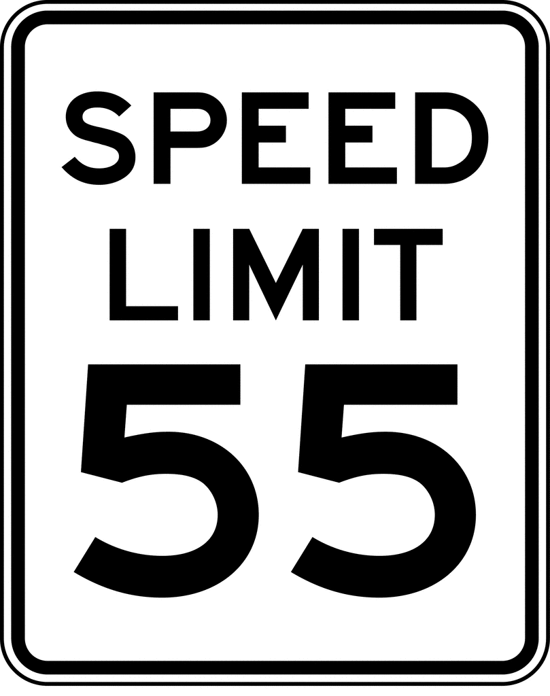

Slide 32
John 12:48-49
⁴⁸ He who rejects Me, and does not receive My words, has that which judges him—the word that I have spoken will judge him in the last day. ⁴⁹ For I have not spoken on My own authority; but the Father who sent Me gave Me a command, what I should say and what I should speak.

Slide 34
Ask for the old paths, enquire of the former age, ask thy fathers/elders…
And you will see that the way of godliness and righteousness has always been the way which God has owned and blessed and in which men have prospered.
Matthew Henry commentary

Slide 35
Ask for the old paths, enquire of the former age, ask thy fathers/elders…
Ask Adam/Eve
Ask Noah
Ask Abraham
Ask Gideon
Ask Peter
Ask Paul

Slide 36
Seeking the old paths means: that there is a path of righteousness and we can find it and we should follow it and we can have rest.

Slide 37
Seek the old paths: the paths prescribed by the law of God, the written word, the truth, the true standard of time.

