Slide 1
*
*
*

Slide 2
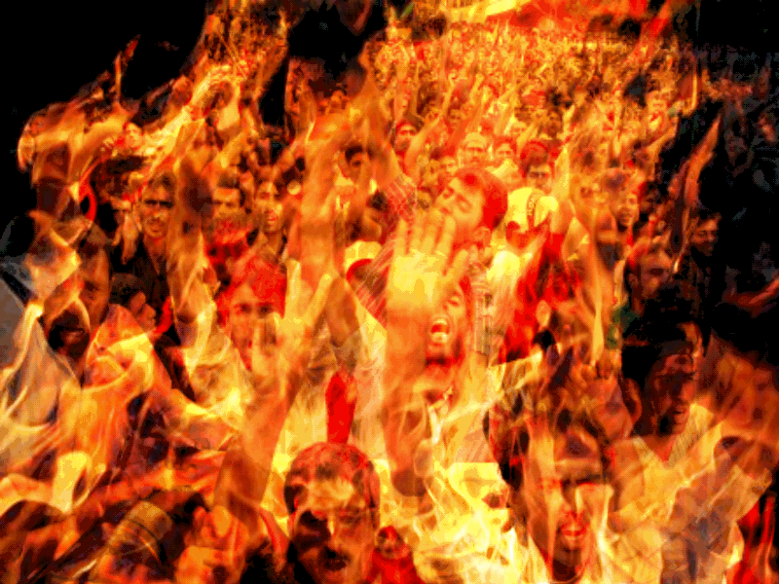
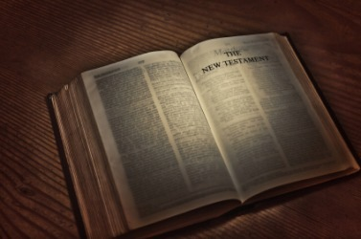
Do You Believe the Bible?
Do You Believe in Hell?

Slide 3
Belief in Hell Among Americans
Wall Street journal, online) NEW YORK
May 29, 2013 /PRNewswire/:
“Against a backdrop of horrific crimes and devastating natural disasters, 56% of Americans surveyed believe in the devil, 53% believe in hell and 43% believe in hell as "a place of suffering and punishment where people go after they die," according to a recent poll of 1,218 Americans conducted over Memorial Day Weekend.”

Slide 4
Belief In Hell Declining
The new survey shows that while a majority of Americans still believe in hell..., the number is declining. A 2008 Pew Forum on Religion & Public Life / US Religious Landscape Survey showed that 59% of Americans believed in hell in 2008, and an earlier Pew study reported that 71% believed in hell as of 2001.

Slide 5
Why the Decline?
“In a pluralistic, post-modern world, students are
having a more difficult time with (the idea of) people going to hell forever because they didn’t believe the right thing ...”
Mike Wittmer, professor of systematic theology
“Americans’ optimism and tolerance for diversity
complements a growing view of God as benevolent,
not judgmental, other experts say.”
Source: Pew Forum: Belief in hell dips, but some say they’ve already been there.

Slide 6
“If your right eye causes you to sin, pluck it out and cast it from you; for it is more profitable for you that one of your members perish, than for your whole body to be cast into hell.
"And if your right hand causes you to sin, cut it off and cast it from you; for it is more profitable for you that one of your members perish, than for your whole body to be cast into hell”
(Matthew 5:29-30).

Slide 7
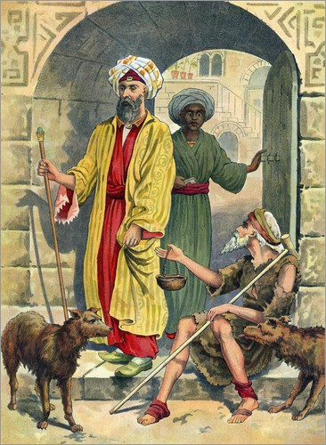
Luke 16:19-31:
A Picture of the Place Called Hell
“Gehenna” = the final destination of the wicked.
2 Peter 2:4 = “Tartarus” = the realm of Hades
where the wicked await the final judgment.

Slide 8
Hell is a place:
Where Perception Is Uninterrupted
Luke 16:22-23
The Lord gave insight into the extent of the
uninterrupted perception in the Hadean realm
(verses 24 & 25).

Slide 9
Hell is a place:
Where Punishment Is Unending
Matthew 25:31-46
The words “everlasting” and “eternal” are
identical in meaning, both translated from the
same word in the original. Therefore, the
durations of “everlasting punishment” and
“eternal life” are the same!

Slide 10
Hell is a place:
Where Petitions Are Unheeded
Luke 16:24,27-28
Abraham’s responses reveal:
Spirits do not return to the living from the dead.
The Word of God is the all-sufficient guide
(2 Timothy 3:16-17; John 20:30-31).

Slide 11
Hell is a place:
Where Paradise Is Unattainable
Luke 16:26
“When the Son of Man comes in His glory, and all the holy angels with Him, then He will sit on the throne of His glory. All the nations will be gathered before Him, and He will separate them one from another, as a shepherd divides his sheep from the goats”
(Matthew 25:31-32).

Slide 12
Hell is a place:
Where Pardon Is Unavailable
“For we must all appear before the judgment seat of Christ, that each one may receive the things done in the body, according to what he has done, whether good or bad”
(2 Corinthians 5:10).

Slide 13
The Dream of God
“For this is good and acceptable in the sight of God our Savior, who desires all men to be saved and to come to the knowledge of the truth”
(1 Timothy 2:3-4).
“The Lord is not slack concerning His promise, as some count slackness, but is longsuffering toward us, not willing that any should perish but that all should come to repentance”
(2 Peter 3:9).

Slide 14
“But the day of the Lord will come as a thief in the night, in which the heavens will pass away with a great noise, and the elements will melt with fervent heat; both the earth and the works that are in it will be burned up”
(2 Peter 3:10).
“Therefore, since all these things will be dissolved, what manner of persons ought you to be in holy conduct and godliness?”
(2 Peter 3:11).
“Nevertheless we, according to His promise, look for new heavens and a new earth in which righteousness dwells”
(2 Peter 3:13).

Slide 15
What is the supreme motivation
for Christian service?
“For God so loved the world that He gave His only begotten Son, that whoever believes in Him should not perish but have everlasting life”
(John 3:16).
“But God demonstrates His own love toward us, in that while we were still sinners, Christ died for us”
(Romans 5:8).

Slide 16
What is the supreme motivation
for Christian service?
“There is no fear in love; but perfect love casts out fear, because fear involves torment. But he who fears has not been made perfect in love. We love Him because He first loved us”
(1 John 4:18-19).
The New Testament Christian,
compelled by love, is not crippled by fear,
but is comforted in hope!

