Slide 1
Dunlap church of Christ Welcome to our worship service.
Sunday, September 22, 2013

Slide 3
Matthew 26:55-56
In that hour Jesus said to the multitudes, “Have you come out as against a robber, with swords and clubs to take me?

Slide 4
Matthew 26:55-56
I sat daily with you, teaching in the temple, and you did not seize me.

Slide 5
Matthew 26:55-56
But all this was done that the Scriptures of the prophets might be fulfilled.

Slide 6
Matthew 26:55-56
Then all the disciples forsook Him and fled.

Slide 8
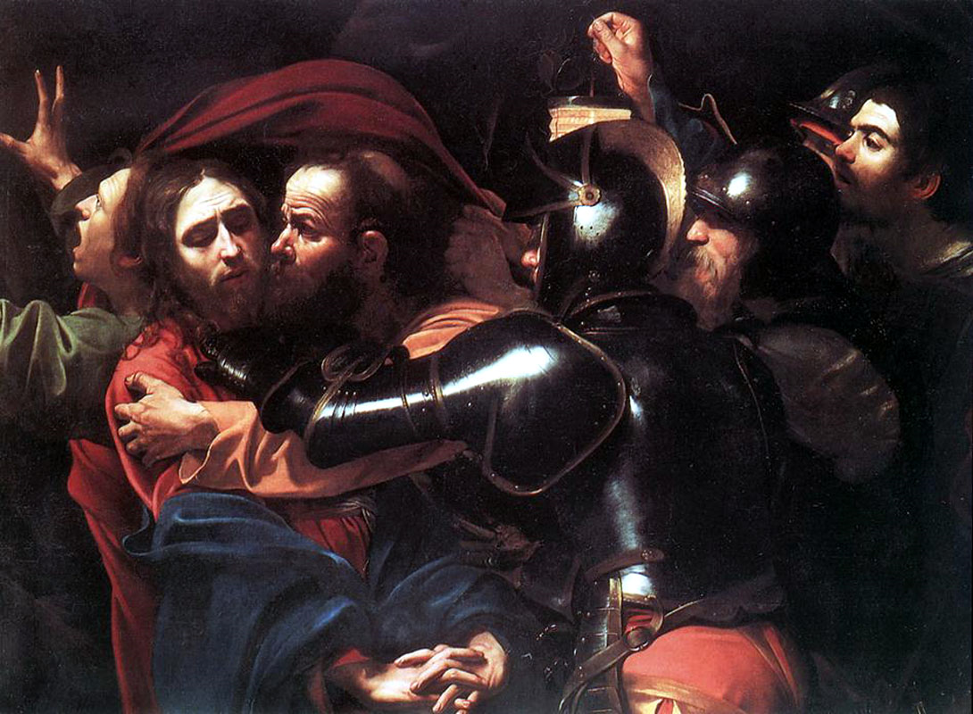

Slide 9
Matthew 26:55

Slide 10
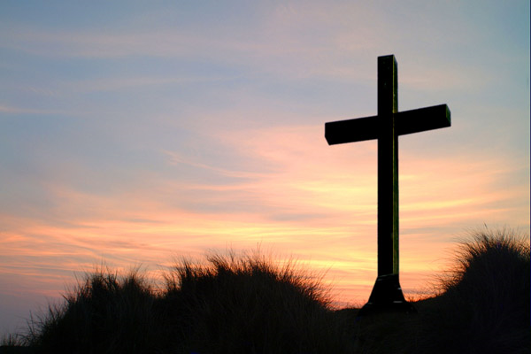

Slide 11
Luke 23:33

Slide 12
The Four Thieves of the Crucifixion

Slide 13
1. The Thief Who Regretted
Judas – John 12:6
Once, Judas was successful and appreciated.
Yet he was fathered by an attitude of greed.
He fell and betrayed the Lord.

Slide 14
1. The Thief Who Regretted
Judas – “He repented of himself”
Matthew 27:3
This is not Acts 2:38 or II Corinthians 7:10 repentance

Slide 15
1. The Thief Who Regretted
Judas – “He repented of himself”
Matthew 27:3 (Metamelomai)
Acts 2:38 (Metanoeo)

Slide 16
1. The Thief Who Regretted
Judas
Acts 2:38 repentance looks backward and forward.
Judas just looked backward.

Slide 17
2. The Thief Who Was Replaced
Barabbas – Matthew 27:15-16
It was custom to release a prisoner at Passover.
The crowd had an opportunity to choose.
Acts 3:14-15

Slide 18
2. The Thief Who Was Replaced
Barabbas
We don’t know his parents or his upbringing.
We do know his lifestyle
Mark 15:7, John 18:40

Slide 19
2. The Thief Who Was Replaced
Barabbas
He was a notable prisoner.
Pilate never mentions his crimes, just the man.

Slide 20
2. The Thief Who Was Replaced
Barabbas means “son of a father”
Jesus was the “Son of the Father”

Slide 21
2. The Thief Who Was Replaced
Barabbas had been tried, convicted, and was waiting.
Pilate had declared Jesus innocent and desired his release.

Slide 22
2. The Thief Who Was Replaced
Jesus took Barabbas’ condemnation, scourging, humiliation, death, and sins when He went to the cross.

Slide 23
3. The Thief Who Rebelled
Matthew 27:38
The fact that Jesus was crucified with thieves is the fulfillment of Isaiah 53:12.

Slide 24
3. The Thief Who Rebelled
All three were:
Nailed
Sagged
Agonized physically

Slide 25
3. The Thief Who Rebelled
And both malefactors railed Jesus (Mt. 27:41-44).
But one kept on railing (Luke 23:39).

Slide 26
3. The Thief Who Rebelled
He forgot
God
Death at hand
His deeds

Slide 27
3. The Thief Who Rebelled
He failed
To see what was most important
To ask for deliverance from sin rather than death

Slide 28
4. The Thief Who Repented
Luke 23:40-43
In terrible pain, he looks to the center cross.
He ceased his scoffing and turns to Jesus in pentitence.

Slide 29
4. The Thief Who Repented
He suffered the same agony but repented, why?
He feared God (Luke 23:40)
He recognized death was close and was concerned what state he died in (40)

Slide 30
4. The Thief Who Repented
He admitted the sinfulness of his own conduct (41)
He was impressed with the innocence of Jesus (42)

Slide 31
The Four Thieves of the Cross
Judas
The Rebellious Thief
The Penitent Thief
And…

Slide 32
The Four Thieves of the Cross
Barabbas
What happened to Barabbas?

Slide 33
The Four Thieves of the Cross
What about you?
What will you do with your new lease on life?

