Slide 1
Welcome!
We Are Glad You Are Here!

Slide 2
Welcome!
Questions? Just Let Us Know!

Slide 3
Exodus 1:8-21
“Now there arose up a new king over Egypt, which knew not Joseph. (9) And he said unto his people, Behold, the people of the children of Israel are more and mightier than we: (10) Come on, let us deal wisely with them; lest they multiply, and it come to pass, that, when there falleth out any war, they join also unto our enemies, and fight against us, and so get them up out of the land.”

Slide 4
(11) Therefore they did set over them taskmasters to afflict them with their burdens. And they built for Pharaoh treasure cities, Pithom and Raamses. (12) But the more they afflicted them, the more they multiplied and grew. And they were grieved because of the children of Israel. (13) And the Egyptians made the children of Israel to serve with rigour:”

Slide 5
(14) And they made their lives bitter with hard bondage, in morter, and in brick, and in all manner of service in the field: all their service, wherein they made them serve, was with rigour. (15) And the king of Egypt spake to the Hebrew midwives, of which the name of the one was Shiphrah, and the name of the other Puah:”

Slide 6
(16) And he said, When ye do the office of a midwife to the Hebrew women, and see them upon the stools; if it be a son, then ye shall kill him: but if it be a daughter, then she shall live. (17) But the midwives feared God, and did not as the king of Egypt commanded them, but saved the men children alive.”

Slide 7
(18) And the king of Egypt called for the midwives, and said unto them, Why have ye done this thing, and have saved the men children alive? (19) And the midwives said unto Pharaoh, Because the Hebrew women are not as the Egyptian women; for they are lively, and are delivered ere the midwives come in unto them.”

Slide 8
(20) Therefore God dealt well with the midwives: and the people multiplied, and waxed very mighty. (21) And it came to pass, because the midwives feared God, that he made them houses.”

Slide 9
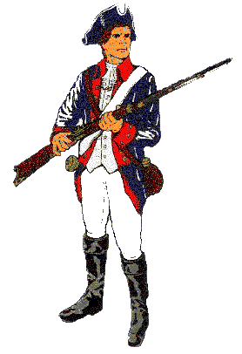
I have always considered myself to be a patriot, a flag-waving nationalist committed to a law-abiding society.

Slide 10
Also A Student of History & The Bible
America, Love It Or Leave It?
Events have forced me to reexamine my views too!
II Corinthians 13:5
My study of Scripture increasingly disturbs my once comfortable co-existence with the system.
I must deal with the fact that our government no longer guarantees every citizen's right to life, liberty and the pursuit of happiness.

Slide 11
Changes
In 1973 the U. S. Supreme Court struck down the laws of all states prohibiting the murder of innocent babies for money.
They declared it unconstitutional for any State or person to prevent or inhibit a woman seeking to hire a "doctor" to kill her baby.
The Supreme Court outlawed the reading of Scripture practice of prayer in public schools; practices engaged in for two hundred years suddenly became illegal.

Slide 12
Changes
The court legalized pornography as freedom of speech. What about responsibility for the flood of violence against women and children that has resulted?
Baby Doe regulations were pronounced unconstitutional, saying in essence that parents can legally pay doctors to deny basic medical care and food to handicapped children. These babies are now legally starved to death.
Dial-a-porn laws were struck down despite the wishes of decent citizens.

Slide 13
Changes
Laws requiring women to be apprised with the risks associated with abortion have been declared illegal.
Laws requiring under-age girls to contact their parents before electing to have an abortion have also been declared illegal.
A year ago the Supreme Court ruled 5-4 making same-sex marriage a right nationwide.
Where will the transgenderism decisions end up?

Slide 14
Despite These Atrocities…
Christians living in our officially pluralistic and religiously neutral society do not feel any great pressure.
AND WHY NOT?

Slide 15
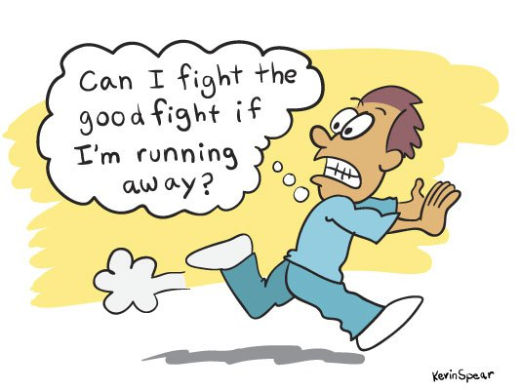
You Do Not Receive Battle Scars When You Are In Full Retreat!

Slide 16
Did We Fight…
When no-fault divorces began in 1969 in California and soon became the norm across the nation?
When pornography was legalized?
When prayer in public schools was declared unconstitutional & teaching evolution required?
When killing babies ceased to be a felony and was declared a constitutional right?
Sadly, Christians largely stood aside and watched the blood flow.

Slide 17
Act Or Be Consumed!
A church is sued for attempting to discipline an adulteress!
Zoning laws which make it illegal to conduct Bible studies in your own home.
Churches being sued because of hiring restrictions based upon gender and/or sexual orientation.
If we keep backing up there soon will be no place to go!

Slide 18
The Time For Playing Games Has Passed!
When Christians turn to the Bible instead of the tradition of world-retreating pietism for answers, they will see a God who calls his people to confront evil in this and every generation.

Slide 19
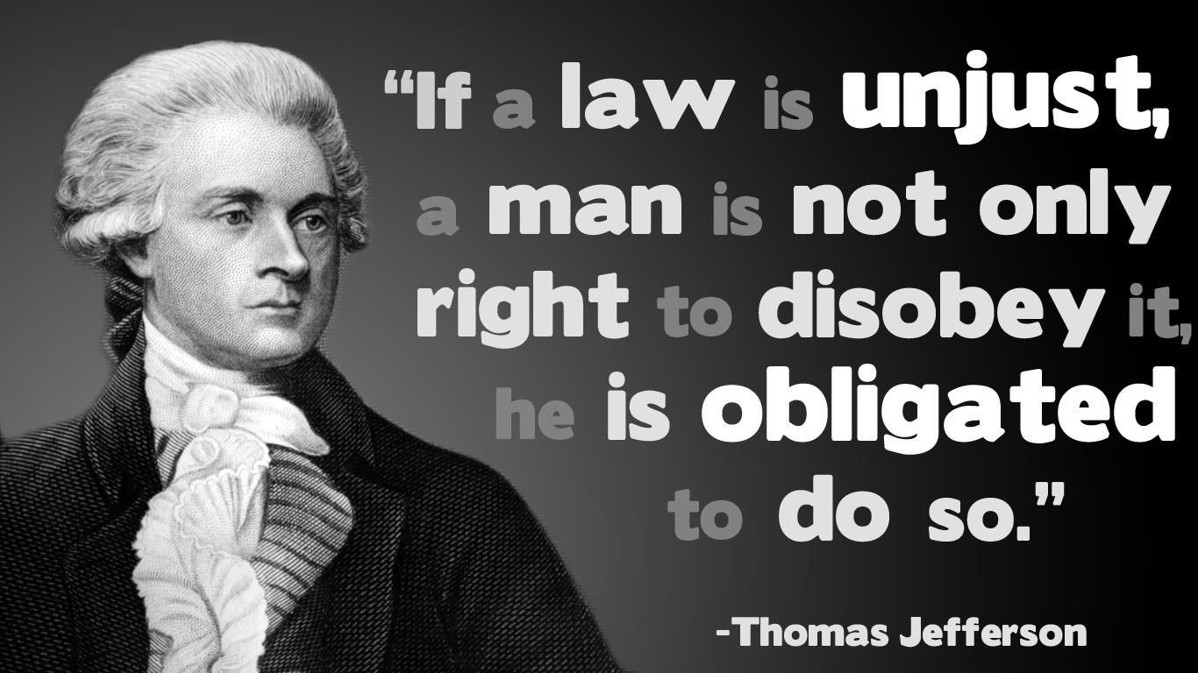
Really?

Slide 20
Civil Disobedience

Slide 21
Anti-Promulgation Position
Christians have a right to disobey the government when it promulgates (proclaims) laws or actions that are contrary to the Word of God.
Anti-Compulsion Position
A Christian should disobey the government when it commands the Christian to do evil.

Slide 22
Compelled To Act Contrary To Our Beliefs
We refer to any civil command that does not simply allow others to act contrary to God’s law, they force believers to disobey God’s commands.
This is oppressive & should be destroyed and disobeyed.
Should we see ourselves as being restricted to these two positions?

Slide 23
Clear Bible Examples
Most of the Divinely approved examples of civil disobedience revolve around believers violating wicked laws in an effort to save innocent lives from death.
Once upon a time those involved in rescuing innocent victims were referred to as heroes!

Slide 24
Civil Disobedience In Scripture
The blessing and approval
of God flowed to people refusing to comply with civil law when compliance would have involved them in taking innocent human life!
Moses was born under a death warrant.
Pharaoh's order to kill all Hebrew boys was a civil law (Exodus 1:16)
The midwives feared God and disobeyed the King's law (Exodus 1:17).
God's response to their choosing to place the sanctity of human life above obedience to the government was positive as He blessed them with families of their own (Ex.1:20-21).

Slide 25
Civil Disobedience In Scripture
Moses' family defied the government to protect his young life, hiding him for three stressful months (Exodus 2:l-4).
Consequently, they are immortalized in the "Hall of Fame of the Faithful" in Hebrews 11 because "they hid him" and "were not afraid of the King's commandment" (Hebrews 11:23).

Slide 26
Civil Disobedience In Scripture
When Moses led the exodus he demonstrated the proper way to approach civil authorities.
He first appealed to Pharaoh to permit Israel to go into the desert to worship the Lord (Exodus 5:l-5).
At first Pharaoh arrogantly refused the request.
After ample persuasion in the form of the ten plagues, Pharaoh granted the Jews such permission.

Slide 27
Exercising his legal prerogative, the King and his officials changed their minds and pursued the Jews (Exodus 14:5-8).
However, the Hebrews did not meekly submit and go back to slavery, which was their legal duty.
Instead, they followed God and Moses across the Red Sea to freedom.
God and his people deliberately and actively defied the authority of the Egyptian government.
The Egyptians were forced to admit, "The Lord is fighting for them against Egypt" (Exodus 14:25)

Slide 28
Egyptian law viewed the Israelites as Pharaoh’s property which gave him the right to release them or call them back on a whim.
The greatest act of slave redemption in the entire Old Testament was a divinely orchestrated act of civil disobedience in which God rescued millions of his people from bondage.
Is this an obscure situation or typical?

Slide 29
Civil Disobedience In Scripture
Rahab To The Rescue (Joshua 2)
Hiding the Hebrew spies from the soldiers wanting to arrest them was an act of high treason from a legal standpoint.
Rahab clearly violated Jericho’s civil law.
In Rahab's case we have an obvious example of being judged ultimately righteous or unrighteous based on obedience to God's law, not civil law (Hebrews 11:31).

Slide 30
Jonathan’s Rescue (I Samuel 14)
The kings' word was law – arrogant Saul issued a foolish arbitrary law in I Samuel 14:24 that nobody could eat anything until the Philistines were defeated.
That law put his men "in distress" (vs. 24) and caused them to faint (vs. 28).
King Saul's son Jonathan unknowingly broke this law.
However, ignorance of the law was not an excuse.
When the Prince was informed of the law he said, "My father hath troubled the land: see, I pray you, how mine eyes have been enlightened, because I tasted a little of this honey. (30) How much more, if haply the people had eaten freely to day of the spoil of their enemies which they found? for had there not been now a much greater slaughter among the Philistines?" (vs.29-30).

Slide 31
Saul called his officers together to determine who had dared to break his law. His men would not incriminate the King's son.
When Saul discovered that it was Jonathan, he was determined to enforce the law by demanding his son's execution (vs. 44).
But, the soldiers flew in the face of Saul's silly law and the consequences of breaking it by saying:
“And the people said unto Saul, Shall Jonathan die, who hath wrought this great salvation in Israel? God forbid: as the LORD liveth, there shall not one hair of his head fall to the ground; for he hath wrought with God this day. So the people rescued Jonathan, that he died not.” (I Samuel 14:45).

Slide 32
The men of Israel defied the law and illegally rescued this innocent life from the unrighteous penalty of an unjust law.
They made it clear that if their appeal to the lawmaker was denied they would intervene.
These soldiers reflected a determination to stand together to keep an innocent man from being legally, but wrongly killed.
For Jonathan to lose his life for eating honey would have been almost as senseless as an unborn baby being killed for being too small, young, or inconvenient.

Slide 33
Obadiah Rescues The Prophets (I Kings 18)
Queen Jezebel, Ahab’s violent wife, was determined to execute the prophets of God.
In a treasonous act of deception and defiance, the king's officer, Obadiah, hid one hundred prophets in caves and provided them with food and water (v.4).
He understood that he must actively, and illegally, keep them from being executed.
In I Kings 18:3, Obadiah was described as a man who “… .feared the Lord greatly."

Slide 34
Civil Disobedience In Scripture
Joash Rescued – II Kings 11
“And when Athaliah the mother of Ahaziah saw that her son was dead, she arose and destroyed all the seed royal. (2) But Jehosheba, the daughter of king Joram, sister of Ahaziah, took Joash the son of Ahaziah, and stole him from among the king's sons which were slain; and they hid him, even him and his nurse, in the bedchamber from Athaliah, so that he was not slain. (3) And he was with her hid in the house of the LORD six years. And Athaliah did reign over the land.”

Slide 35
Civil Disobedience In Scripture
Jeremiah (Jeremiah 38:1-6)
Shadrach, Meshach, & Abednego (Dan.3)
Daniel (Daniel 6)
Esther (Esther 4:14)
The Wise Men (Matthew 2)
Apostles (Acts 5)
Angels (Acts 12)

Slide 36
Clear Bible Examples
1. Numerous documented examples of godly people practicing civil disobedience.
2. God directly orders his people to engage in civil disobedience in some cases (e.g. Jeremiah, the wise men).
3. In several cases God condones and rewards civil disobedience as an act of obedience to him after-the-fact (e.g. the midwives, Moses' parents, Rahab, and Daniel).

Slide 37
Clear Bible Examples
4. The contexts of several passages show acts of civil disobedience were right even though it is not explicitly stated (e.g., the men of Israel saving Jonathan, Obadiah saving the prophets, Jehosheba saving the infant Joash, and Esther saving the Jews).
In virtually every instance the ultimate motive was to obey the Lord. The Bible plainly shows that civil disobedience is justified at least in the areas of the sanctity of human life, worship, and evangelism.

Slide 38
II Peter 1:3-4
“According as his divine power hath given unto us all things that pertain unto life and godliness, through the knowledge of him that hath called us to glory and virtue: (4) Whereby are given unto us exceeding great and precious promises: that by these ye might be partakers of the divine nature, having escaped the corruption that is in the world through lust.”

