Slide 2
Mass Media The mass media are diversified media technologies that are intended to reach a large audience by mass communication. The technologies through which this communication takes place varies. Broadcast media such as radio, recorded music, film and television transmit their information electronically.

Slide 3
Public speaking and event organising can also be considered as forms of mass media.[3] The digital media comprises both Internet and mobile mass communication. Internet media provides many mass media services, such as email, websites, blogs, and internet based radio and television. Many other mass media outlets have a presence on the web, by such things as having TV ads that link to a website,

Slide 4
Act 2:36 Therefore let all the house of Israel know assuredly, that God hath made that same Jesus, whom ye have crucified, both Lord and Christ.
Act 2:37 Now when they heard this, they were pricked in their heart, and said unto Peter and to the rest of the apostles, Men and brethren, what shall we do?

Slide 5
Act 2:38 Then Peter said unto them, Repent, and be baptized every one of you in the name of Jesus Christ for the remission of sins, and ye shall receive the gift of the Holy Ghost.

Slide 6
Act 2:41 Then they that gladly received his word were baptized: and the same day there were added unto them about three thousand souls.

Slide 7
Mat 28:18 And Jesus came and spake unto them, saying, All power is given unto me in heaven and in earth.
Mat 28:19 Go ye therefore, and teach all nations, baptizing them in the name of the Father, and of the Son, and of the Holy Ghost:
Mat 28:20 Teaching them to observe all things whatsoever I have commanded you: and, lo, I am with you alway, even unto the end of the world. Amen.

Slide 8
Mar 16:15 And he said unto them, Go ye into all the world, and preach the gospel to every creature.
Mar 16:16 He that believeth and is baptized shall be saved; but he that believeth not shall be damned.

Slide 9
Mat 10:36 And a man's foes shall be they of his own household.
Mat 10:37 He that loveth father or mother more than me is not worthy of me: and he that loveth son or daughter more than me is not worthy of me.
Mat 10:38 And he that taketh not his cross, and followeth after me, is not worthy of me.

Slide 10
Jer 6:16 Thus saith the LORD, Stand ye in the ways, and see, and ask for the old paths, where is the good way, and walk therein, and ye shall find rest for your souls. But they said, We will not walk therein.

Slide 11
Act 5:29 Then Peter and the other apostles answered and said, We ought to obey God rather than men.

Slide 12
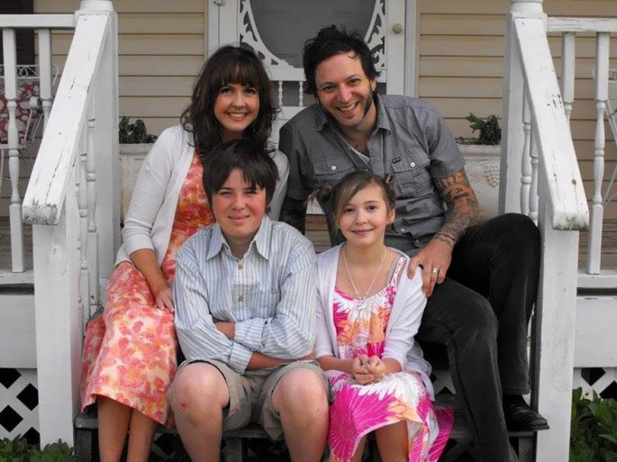

Slide 13
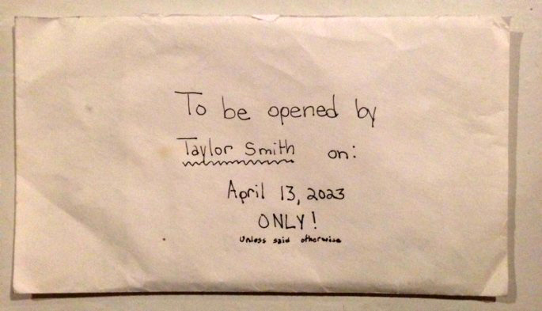

Slide 14
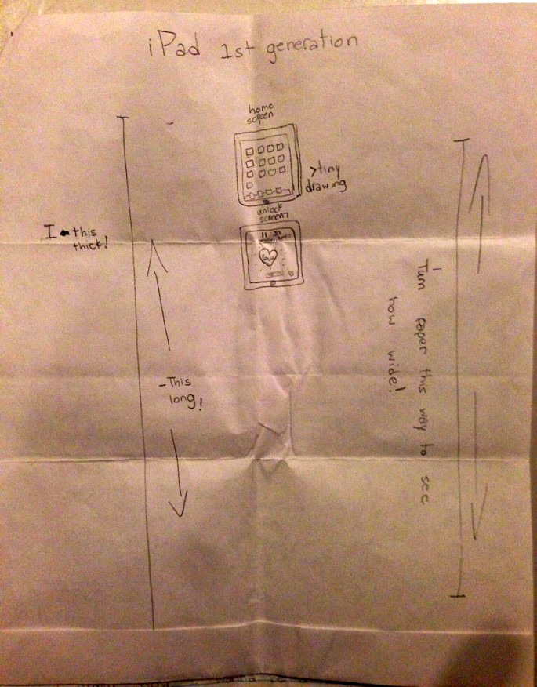

Slide 15
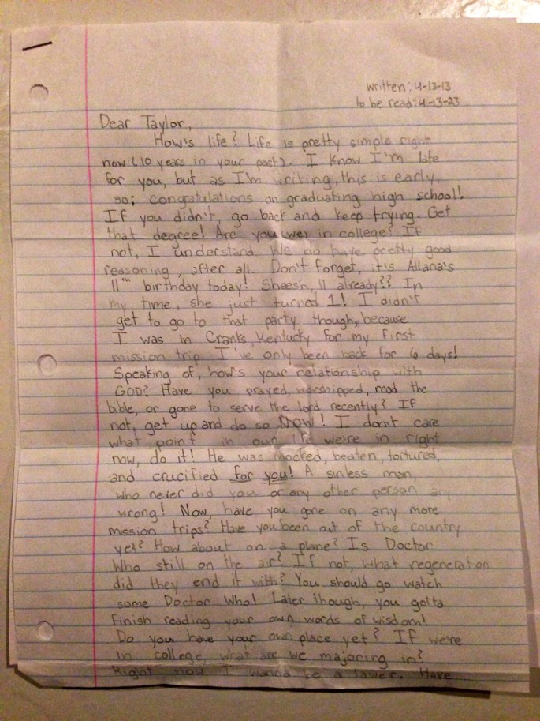

Slide 16
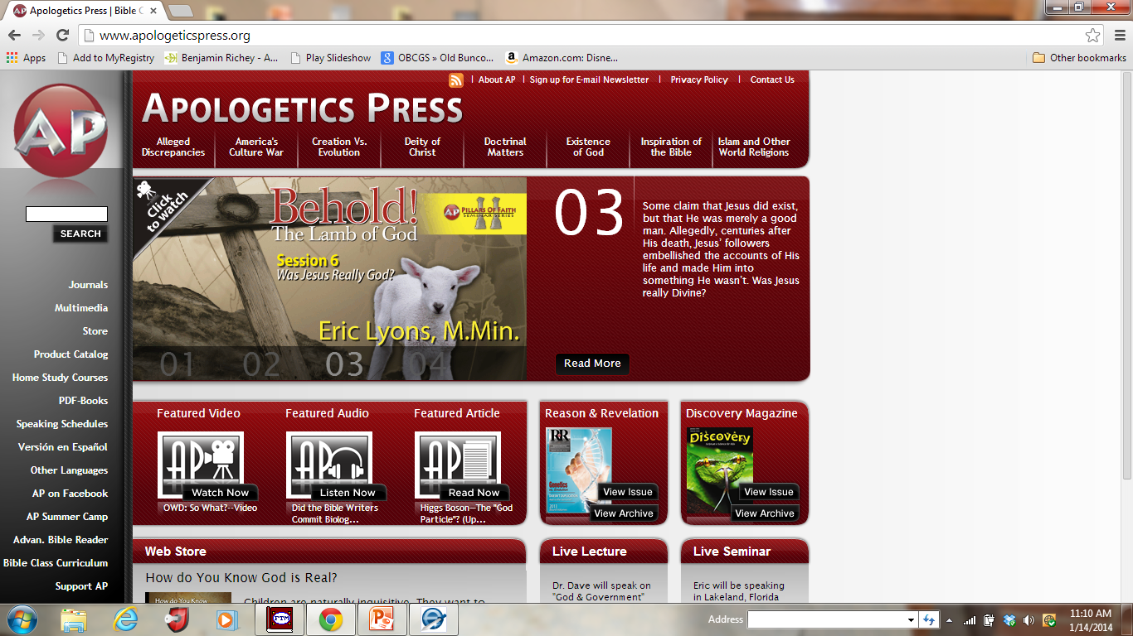

Slide 17
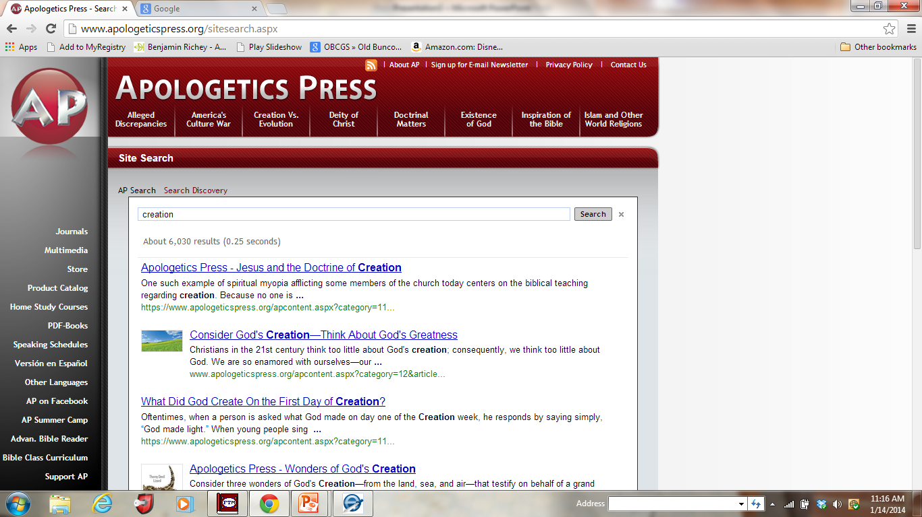

Slide 18
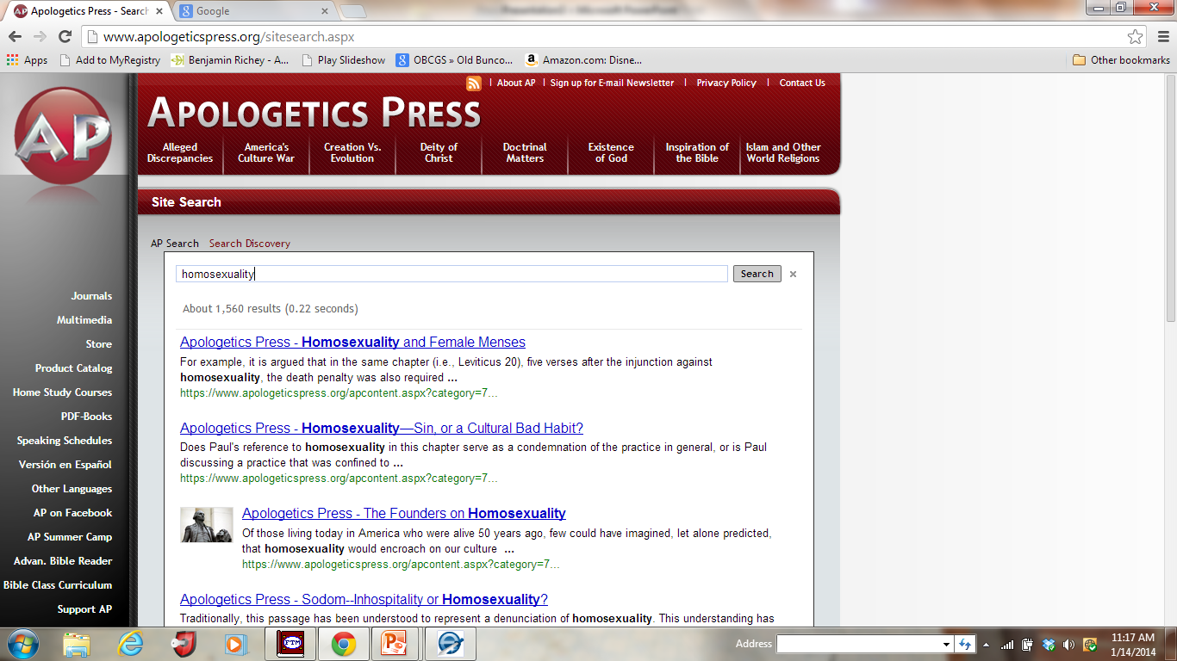

Slide 19
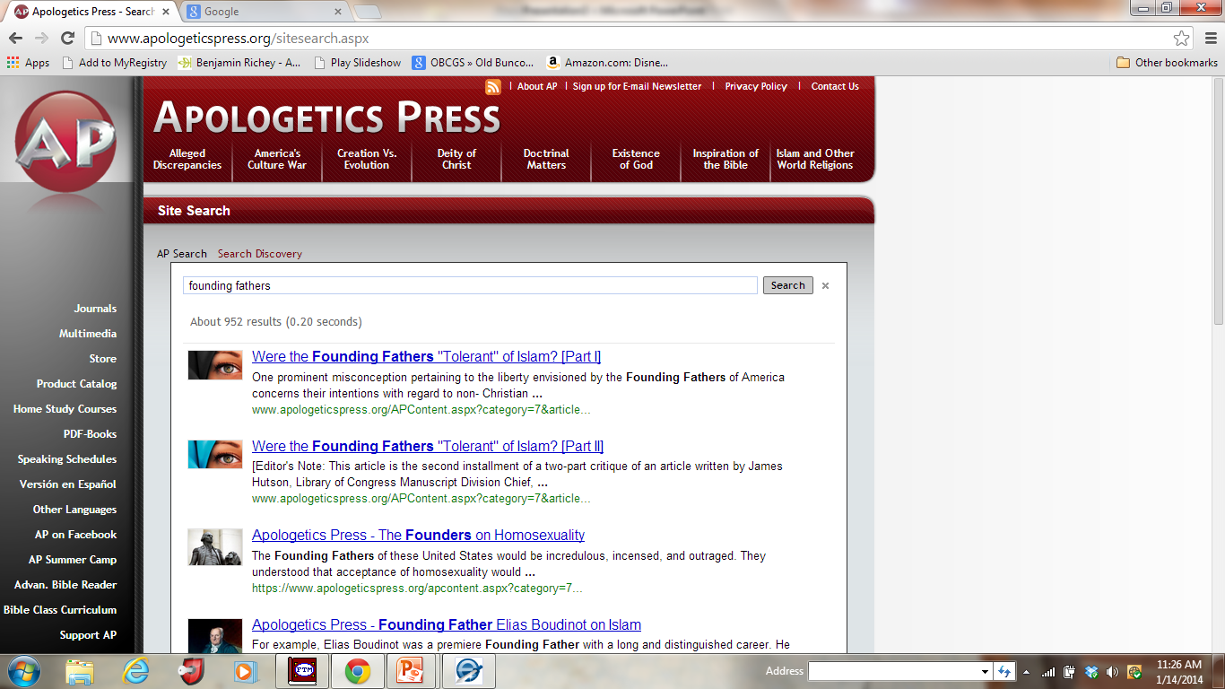

Slide 21
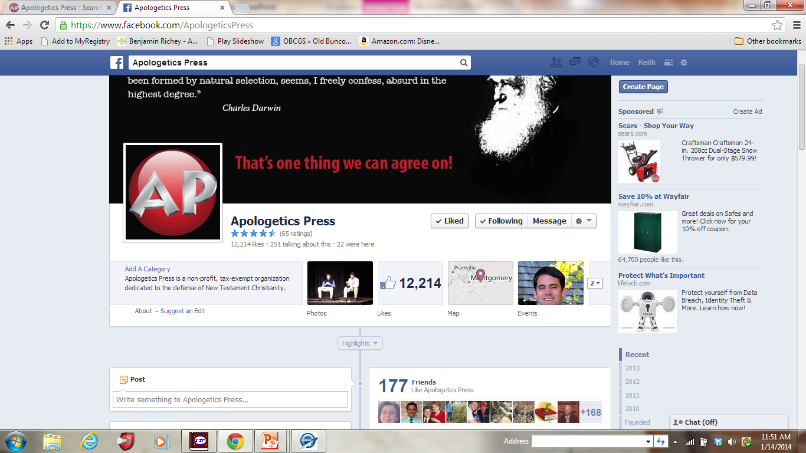

Slide 22
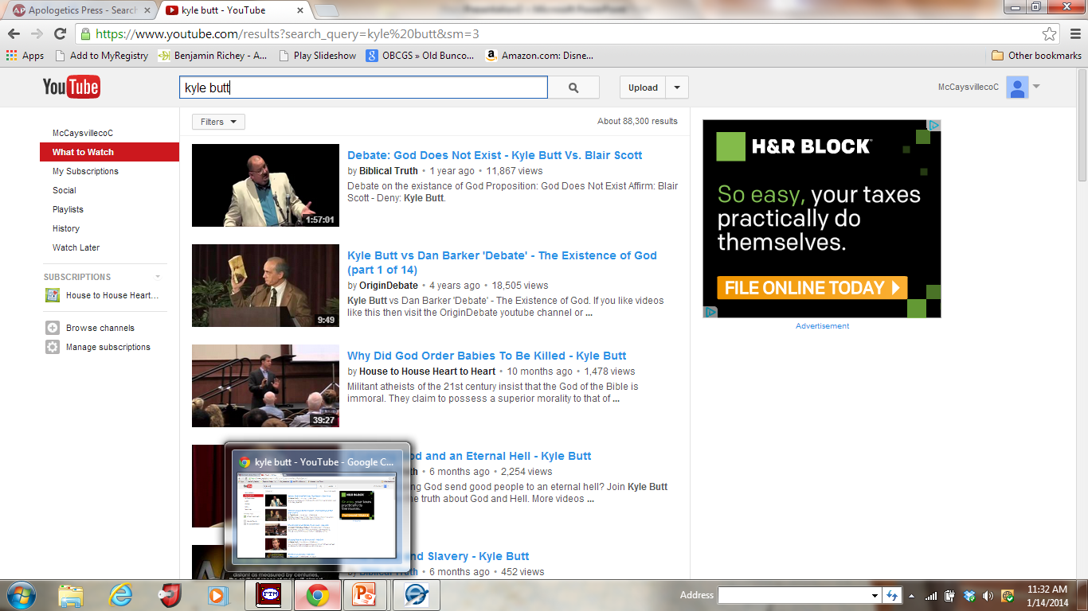

Slide 32
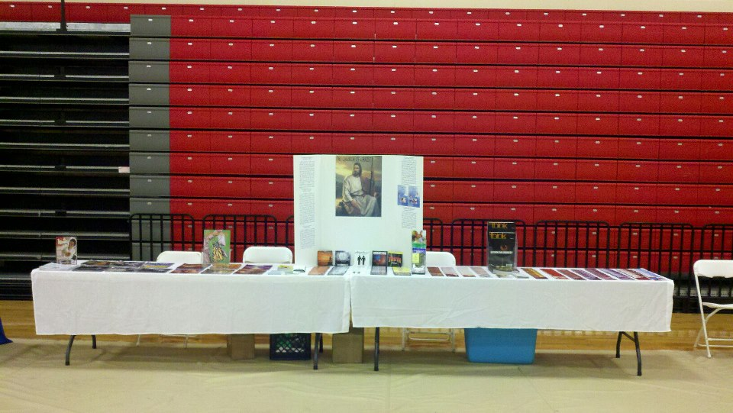

Slide 34
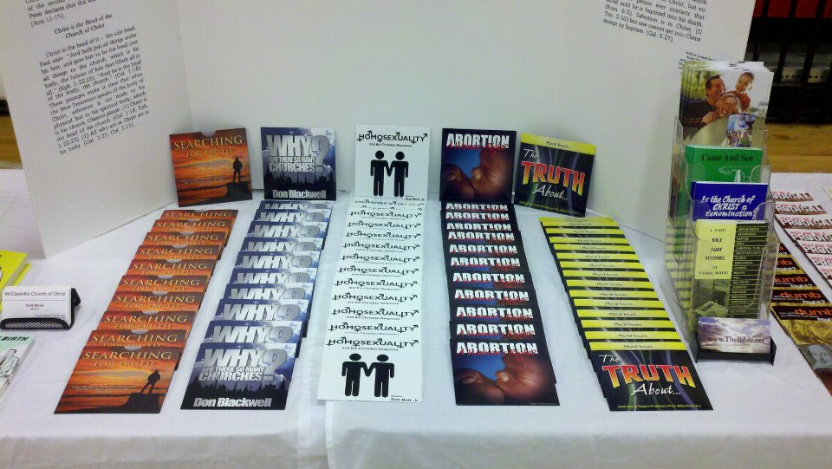

Slide 40
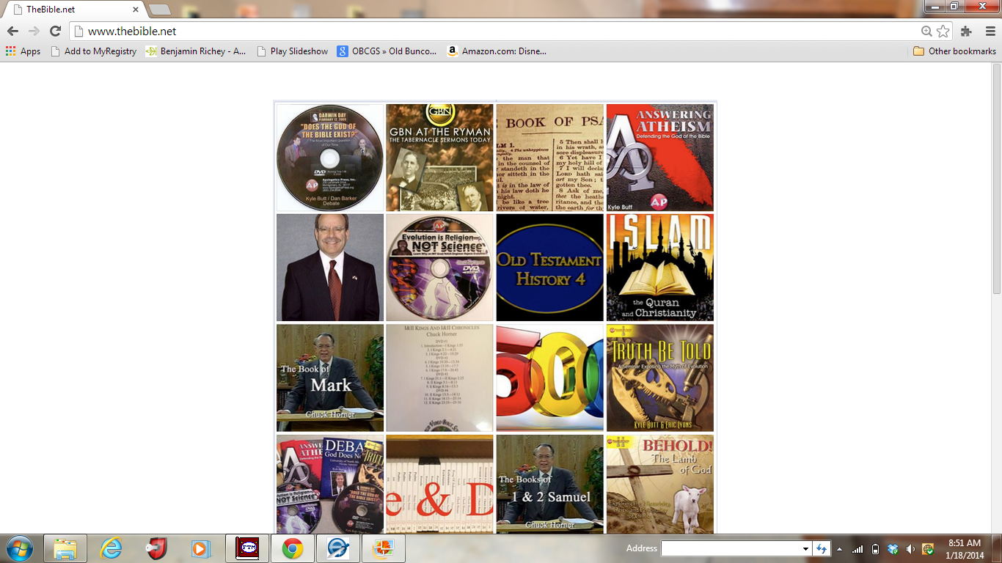

Slide 41
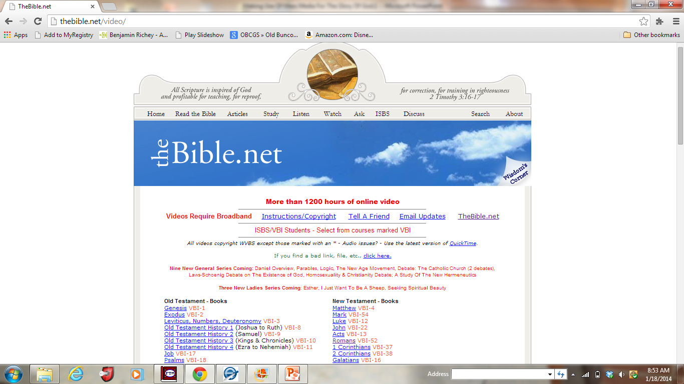

Slide 44
