Slide 1


Slide 3
I John 2:9-11
“He that saith he is in the light, and hateth his brother, is in darkness even until now. (10) He that loveth his brother abideth in the light, and there is none occasion of stumbling in him.”

Slide 4
I John 2:9-11
“(11) But he that hateth his brother is in darkness, and walketh in darkness, and knoweth not whither he goeth, because that darkness hath blinded his eyes.”

Slide 6
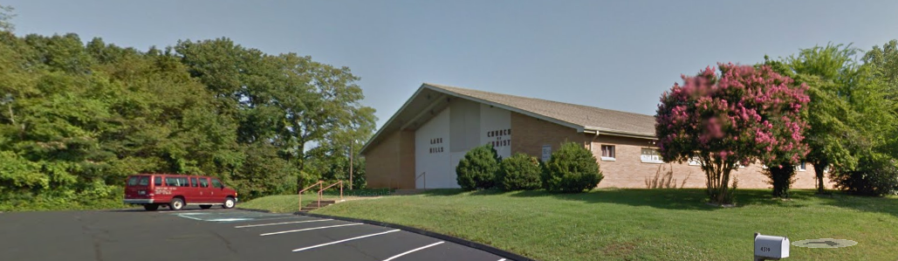

Slide 7


Slide 8
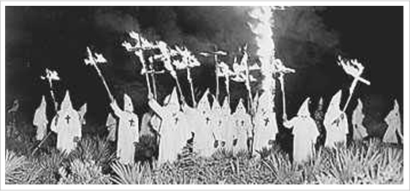

Slide 9
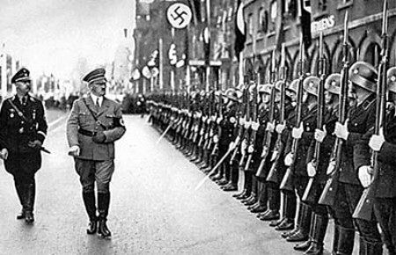

Slide 10
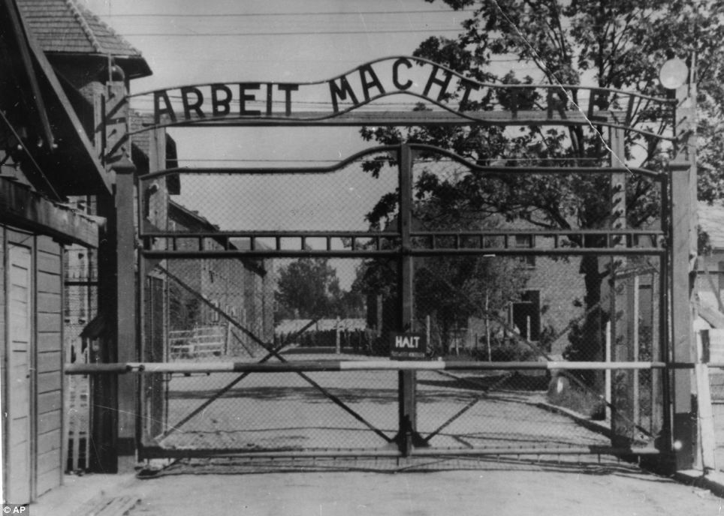

Slide 11
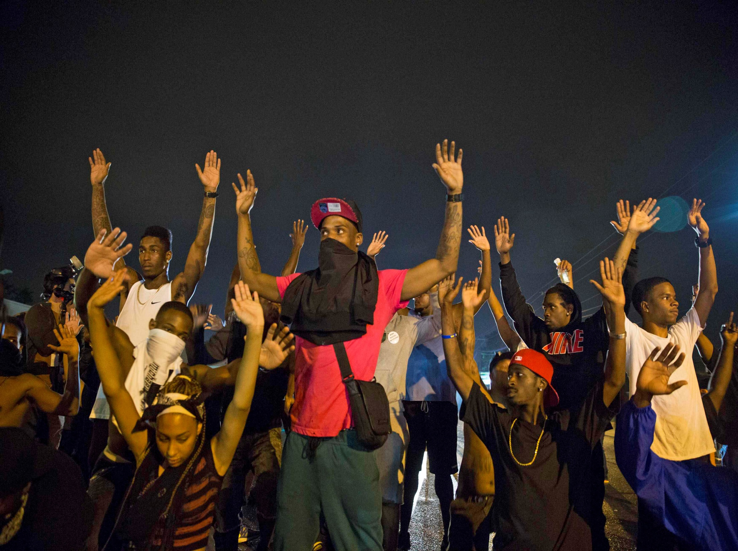

Slide 12
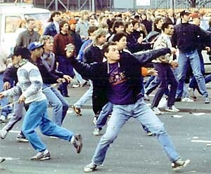

Slide 13
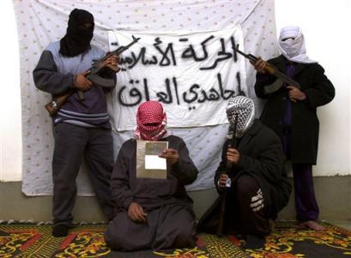

Slide 14
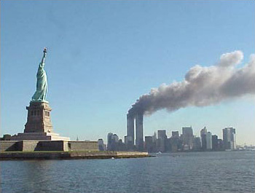

Slide 15


Slide 16
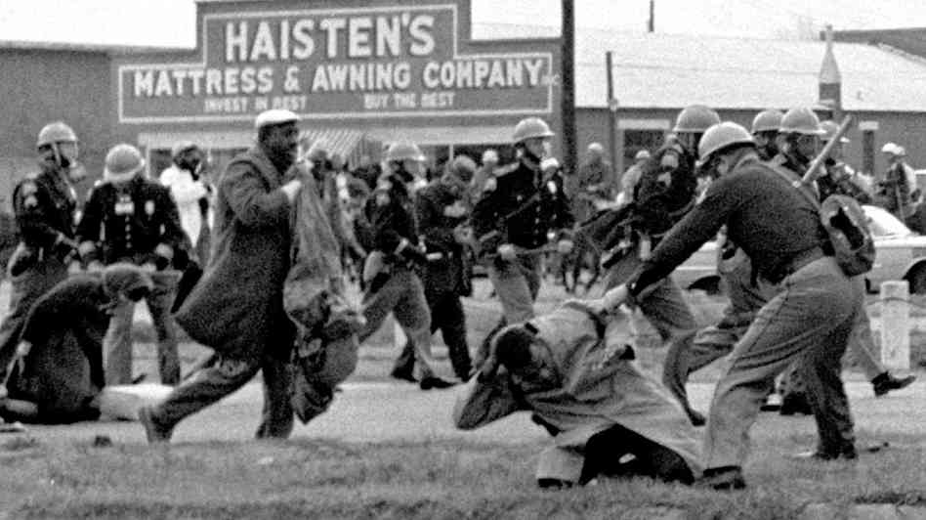

Slide 17


Slide 18
We live in a society that misunderstands and misapplies the term “hate”.

Slide 19
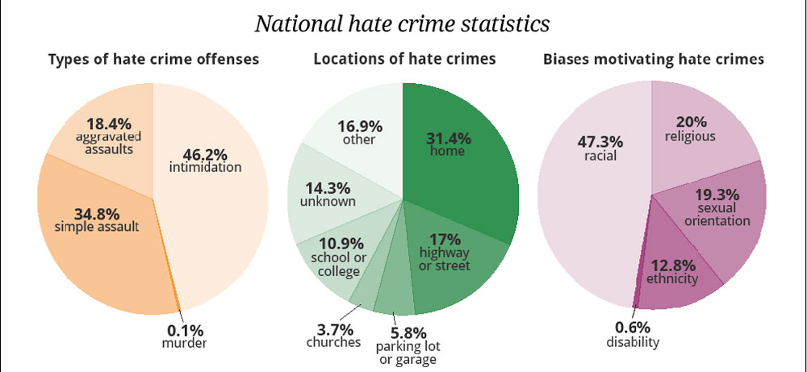

Slide 20


Slide 21
We must understand hate.

Slide 22
We cannot love as we should without hating.
We must hate the right things in the right way.

Slide 23
W.E. Vine’s Expository Dictionary of N.T. Words
Malicious and unjustifiable feelings toward others, whether towards the innocent or by mutual animosity.

Slide 24
W.E. Vine’s Expository Dictionary of N.T. Words
This is condemned (I John 2:9-11)
Malicious and unjustifiable feelings toward others, whether towards the innocent or by mutual animosity.
I John 3:15

Slide 25
W.E. Vine’s Expository Dictionary of N.T. Words
Malicious and unjustifiable feelings toward others, whether towards the innocent or by mutual animosity.
Relative preference of one thing over another.

Slide 26
W.E. Vine’s Expository Dictionary of N.T. Words
Malicious and unjustifiable feelings toward others, whether towards the innocent or by mutual animosity.
Relative preference of one thing over another.
A feeling of aversion from what is evil or towards error.

Slide 27
God Hates

Slide 28
God Hates
I John 4:8

Slide 29
God Hates
2. Relative preference
God “hated” Esau
(Rom. 9:13)

Slide 30
God Hates
3. Dislike towards evil
Idolatry
(Jer. 44:2-5)
Seven Things
(Prov. 6:16-19)

Slide 31


Slide 32
Relative Preference
Matthew 6:24
A person cannot serve two masters.

Slide 33
Relative Preference
Luke 14:25-26
1. One must hate his own family

Slide 34
Relative Preference
Luke 14:25-26
One must hate his own family
One must hate his own life.

Slide 35
Relative Preference
What do you prefer?
What do you put first?

Slide 37
Aversion from what is evil
Psalm 119:104
We must hate every false way.

Slide 38
Aversion from what is evil
II Thess. 2:10-12
What we believe makes a difference

Slide 39
Aversion from what is evil
Revelation 2:6
The church at Ephesus was commended for “hating”

Slide 40
Aversion from what is evil
Psalm 97:10
We must hate evil.

Slide 41
Aversion from what is evil
Psalm 51:4
Sin is against God.

Slide 42
Aversion from what is evil
Why do people not hate evil?
Because they do not love God.

Slide 44
Gospel Plan of Salvation
Hear – the Word
Believe – In Christ
Repent – of your sins
Confess – the name of Jesus
Be Baptized – for the forgiveness of your sins

Slide 49
The Simple Plan
HEAR – Rom.10:17; Jno.20:30,31
BELIEVE – John 8:24; Hebrews 11:6
REPENT – Luke 13:3; Acts 17:30,31
CONFESS – Romans 10:10; Acts 8:37
BE BAPTIZED – Mk.16:16; Acts 22:16
ADDED TO CHURCH (Acts 2:41,47)

